Slide 1

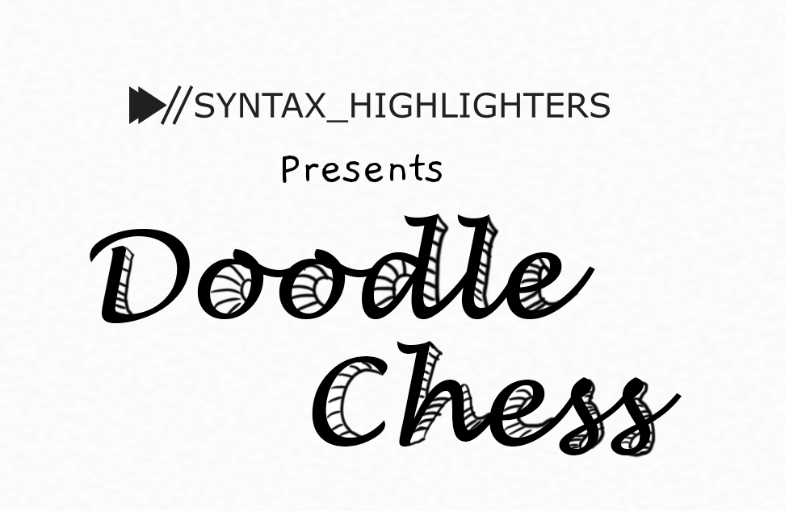




Slide 2


INF 112
OBLIG 5
GROUP 6
TEAM PRESENTATION

Slide 3

GRUPPE 6
Sverre – Code
Loc - Graphics
Benjamin – SQL
Eirik – Code
Stian – AI & Version control
Vegard – Documentation & UI
Robin E – UI
Robin G – UI
1
of
8

Slide 4
RESULTS &
CHALLENGES
Fire-chess
Sjadam
Online game
Improved workload distribution
Refactoring
2
of
8

Slide 5
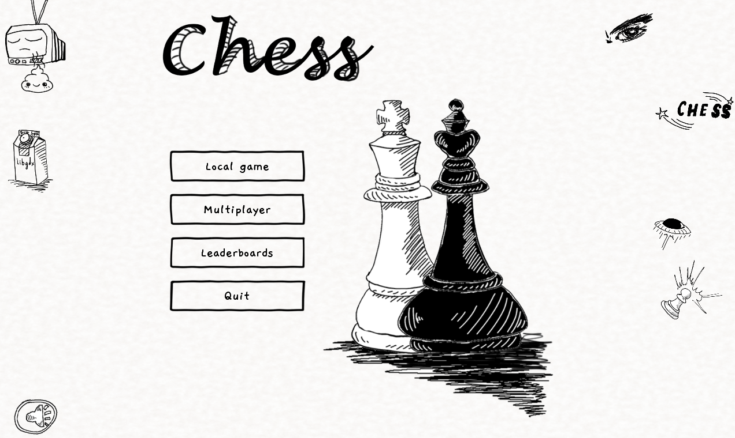
3
of
8

Slide 6
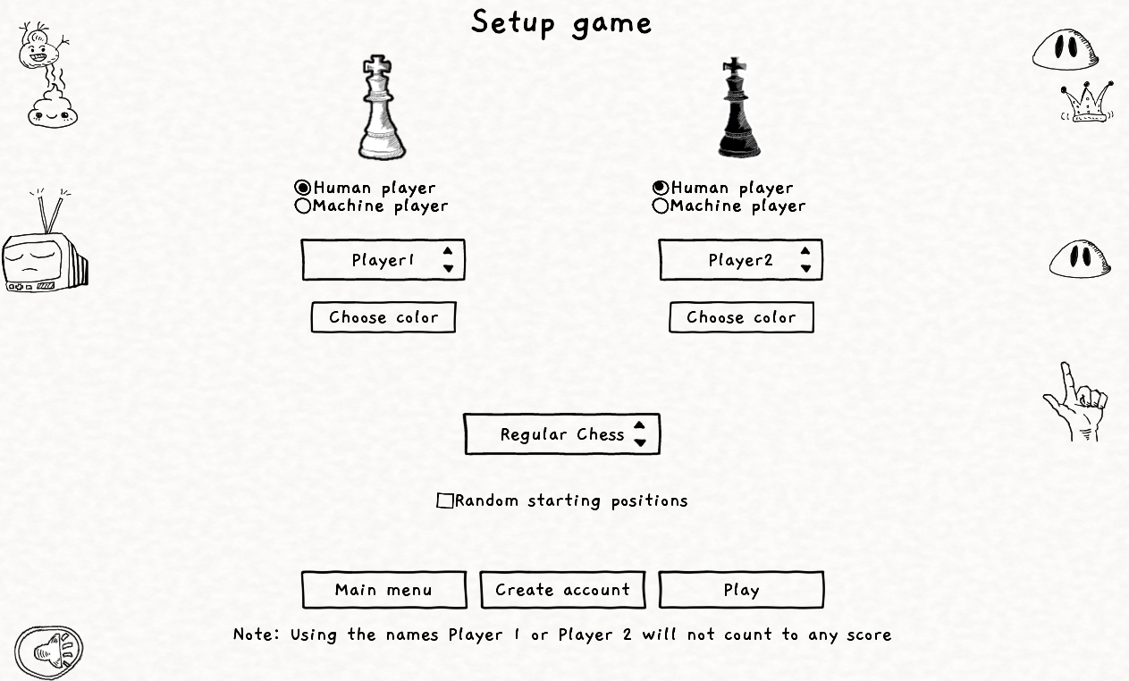
4
of
8

Slide 7
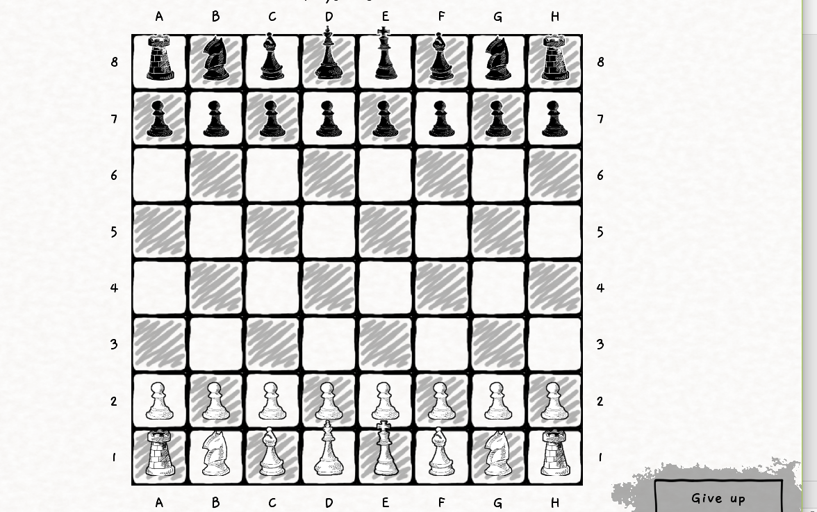
5
of
8

Slide 8
DEMOVIDEO
See /gruppe-6/docs/DoodleChess Demo.mp4
6
of
8

Slide 9
Retrospective
Much improved distribution of workload.
Managed to spread knowledge of subsystems and avoid single-responsibility.
Pair programming worked well.
Refactoring as needed kept the project extendable and modular.
Some feature creep.
Workload shifted to last-second again.
Several suggested features and improvements (and some bugs) remain for a hypothetical next sprint.
7
of
8

Slide 10
THANK YOU

